Slide 1
Placement Prediction using ML
Guide : L.J.Deovkate
Name :Rohit Rajendra Gaikwad
Roll no :40
Branch & Div :IT

Slide 2
INTRODUCTION
A placement predictor will help to determine the likelihood of a student getting placed in a firm based on the company's criteria.
The placement predictor will into account several factors that may be used to determine a student's ability level.
Some criteria are derived from university assessments, while others are derived from tests completed within the placement management system.
The predictor will use these data points to properly estimate whether the student will be placed in a firm or not . The predictor is trained using data from previous pupils.

Slide 3
Problem Statement
To create a placement predictor using various ML algorithms which will predict whether a candidate will be placed in firm on not based on different attributes By which a candidate's ability can be judged

Slide 4
Literature review
SNO | Year | Paper title | Description
1 | 2020 | Placement Prediction using Various Machine Learning Models and their Efficiency Comparison | Logical Regression, Random Forest, KNN, and SVM are used to complete the scenario expectation in this article. SVM has a precision of one hundred percent. On the given dataset, Logistic Regression also performs well, with an accuracy of 97.59. SVM, Logistic Regression, Random Forest, and KNN are all good for binary classification tasks, as shown by the results, since they all yield accuracy of over 95 percent.
2 | 2019 | Student Placement Prediction Model: A Data Mining Perspective for Outcome-Based Education System | To find patterns in the data that are connected with the prediction model, machine learning methods such as KNN (K-Nearest Neighbors), SVM (Support Vector Machine), and ANN (Artificial Neural Network) were used. Technical events attended, internships done, certification courses finished, and CGPA gained were among the qualities chosen

Slide 5

Tools and Algorithm Used
Python
Pandas and sklearn
Algorithms : Logistic Regression ,Decision tree, Random forest
HTML and CSS for User Interface
Flask framework for backend

Slide 6
Methodology
Imported pandas module for creating a data frame
Created a data frame using pandas.read_csv() function amd passing file location as an attribute
Preformed data preprocessing
Preformed splitting of dataset into training and testing parts with 80-20 ratio
From sklearn imported necessary classes to of the required algorithms and created their objects
Passed the training dataset as parameter for our model
Evaluated the accuracy of our model using score function of sklearn
Saved the trained model in pickle file
Created the front end and backend for the predictor

Slide 7
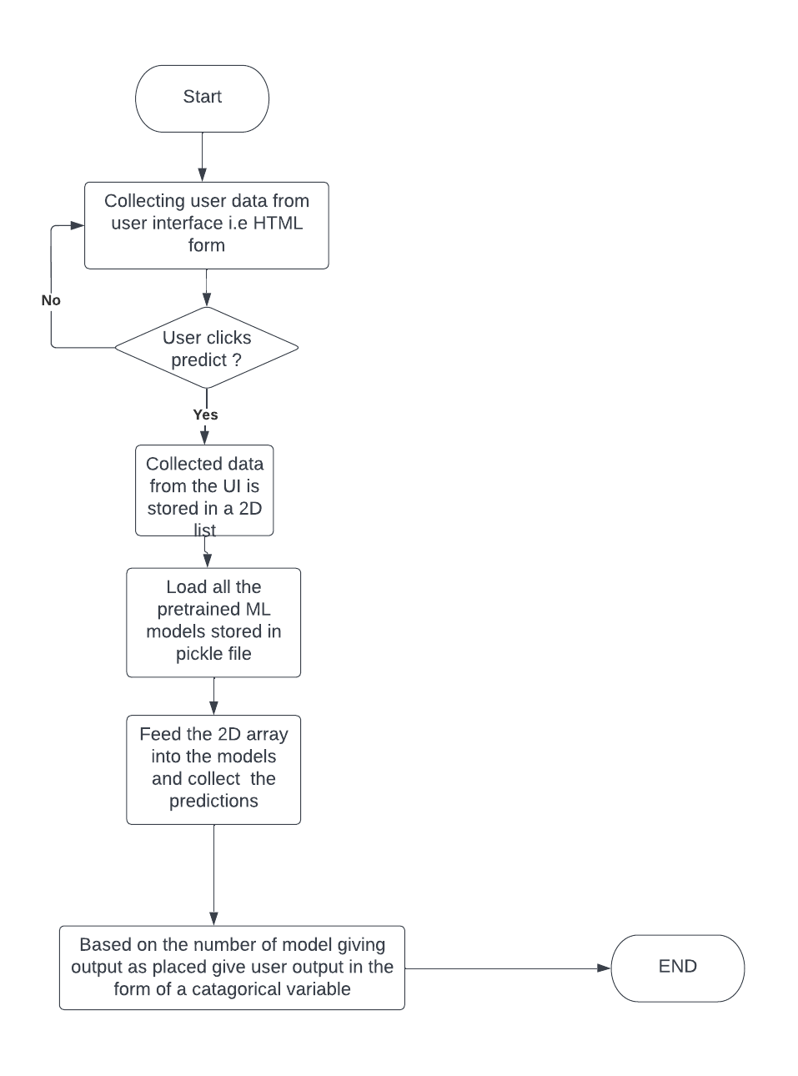
Project Flow :

Slide 8
Results and Future Work
The accuracy for logistic regression is around 87% and for decision tree its around 83% and for Random forest it was around 95%
Whenever the user enters his details in the UI and clicks on the predict button he/she will get the his/her chances of getting placed in the of categorical variable
Will try to add more algorithms in our predictor to get better result

Slide 9
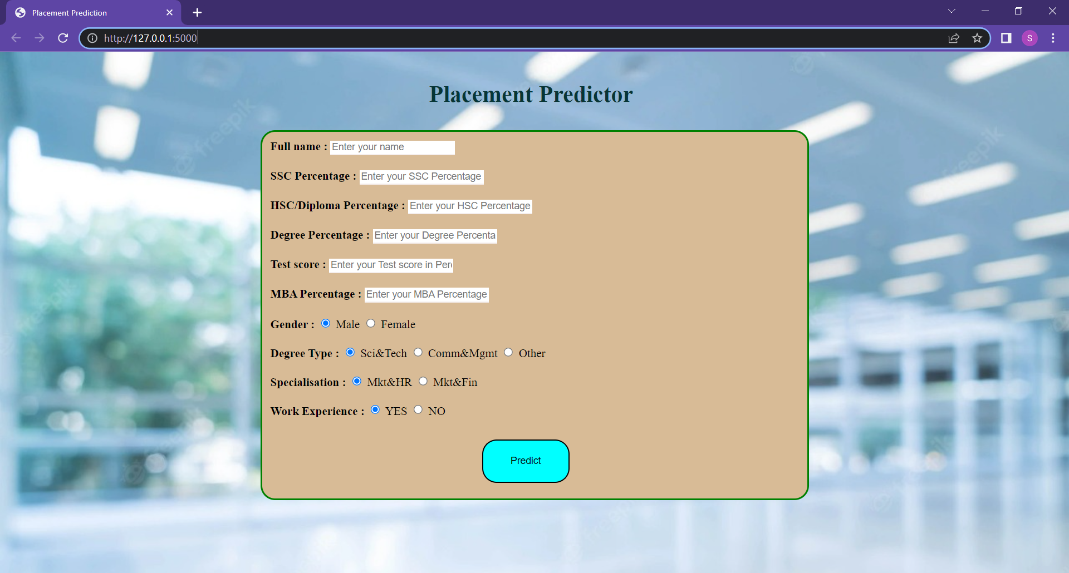
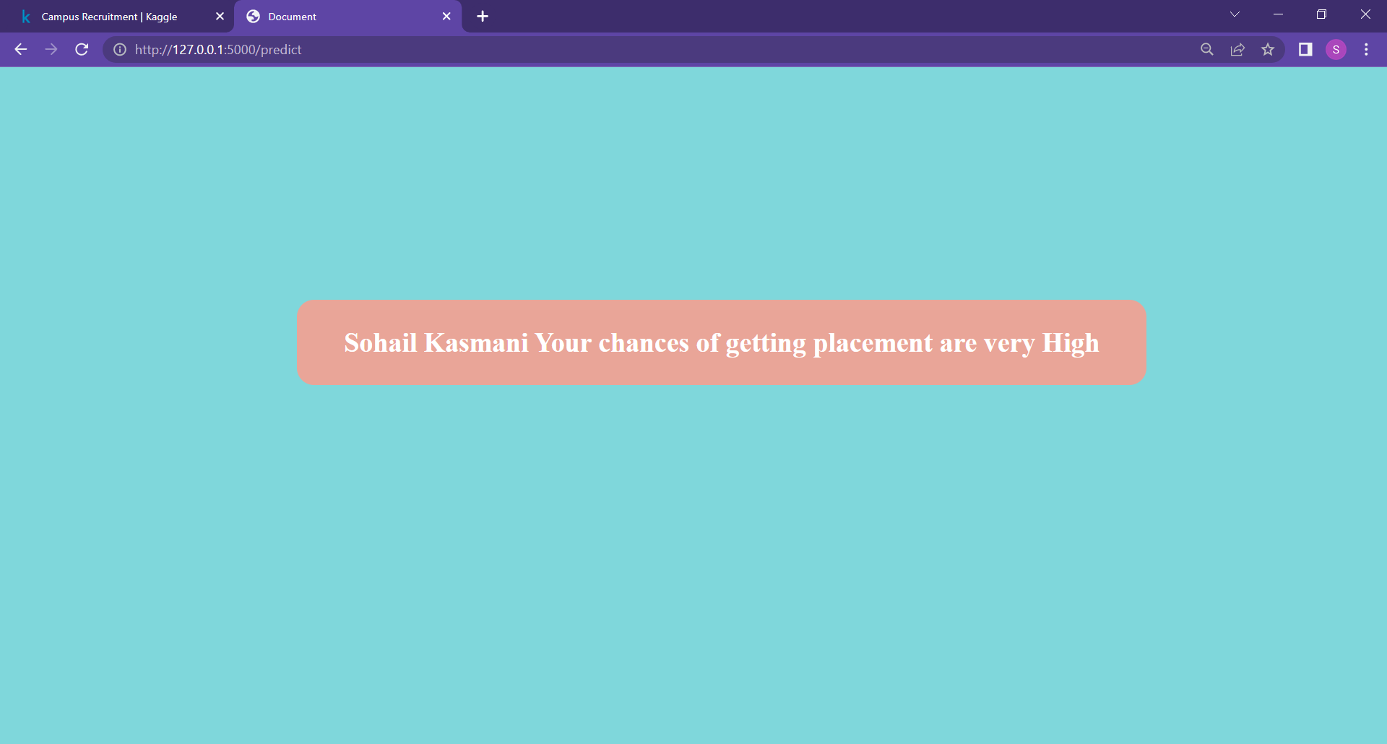
Fig 1
Fig 2
The above figure 1 shows the UI(front end) of the predictor which is basically an html form to collect different attribute of the candidate
In the above figure 2 you can see the once a candidate fills his details and hits predict button he/she will see his/her chances of getting places in the form of a categorical variable like high ,low ,etc. this value depends on how many models which we created give output as places

Slide 10
References :
[1] Nikhil Kumar, Thirunavukkarasu K., Ajay Shanker Singh, E. Rajesh, “Campus Placement Predictive Analysis using Machine Learning”, 2nd International Conference on Advances in Computing, Communication Control and Networking (ICACCCN), 2020
[2] Dr. B. Muthusenthil , Venkat Mugesh S , Thansh D , Subaash R, “Predictive Analysis Tool for Predicting Student Performance and Placement Performance using ML algorithms”, 2020
[3] Mrs. J. Samatha, D. Manjusha, B. Pooja, A. Usha, “STUDENT PLACEMENT CHANCE PREDICTION”, May 2020
[4] Irene Treesa Jose , Daibin Raju , Jeebu Abraham Aniyankunju, Joel James, Mereen Thomas Vadakkel,” Placement Prediction using Various Machine Learning Models and their Efficiency Comparison”, International Journal of Innovative Science and Research Technology, 2020
[5] https://www.geeksforgeeks.org/pandas-tutorial/
[6] https://www.simplilearn.com/tutorials/machine-learning-tutorial/logistic-regression-in-python

Slide 11
Thankyou

